Slide 1

EU Energy Efficiency policy
Behavioural policy measures in the Energy Efficiency Directive
and RePowerEU Save Energy plan
BEHAVE Conference 2023,
28/11/2023
Margot Pinault, Energy Efficiency Unit, ENER.B2, European Commission

Slide 2







Policy context - Overview
European Green Deal - Overarching policy
EU to be climate neutral by 2050 and cut GHG emissions by at least 55% by 2030
Fit for 55 package - Delivering the Green Deal
Set of interconnected proposals, including revision of key legislation EED, EPBD, RED
+ REPowerEU - package aiming to phase out EU dependence from Russia’s fossil fuel imports by 2027

Slide 3




REPowerEU
A roadmap to reduce the dependence on Russian fossil fuels and fast forward the energy transition without leaving anyone behind
Based on 3 pillars:
Energy saving and energy efficiency
Save Energy plan to guide Member States in reducing energy consumption
Diversification of our energy supplies
Massive acceleration of investment in renewables

Slide 4
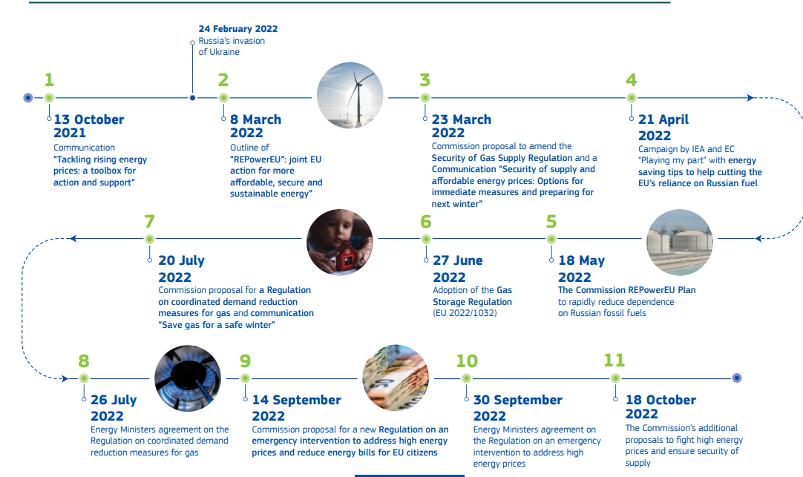
EU Response at a Glance
2021-2022
EU Energy Platform
Save Gas for a Safe Winter
European Gas Demand Reduction Plan
Regulation on Emergency intervention to Address High Energy Prices
RePowerEU Plan
Gas Storage Regulation
Gas Demand Reduction Regulation

Slide 5
Member State measures under Save Energy Plan & Save Gas for Safe Winter
Around 60 measures reported by MS ranged from energy savings campaigns and actions to energy efficiency programmes as well as voluntary curtailment measures:
Reducing public lighting hours,
Reducing the heating or cooling of buildings.
Awareness raising campaigns
Financial incentives for energy efficiency improvement, fossil fuel technology replacement (boilers, cars) and RES installation
Electricity load shedding (e.g. shifting of water electric boiler to reduce peak demand)
Some measures go beyond energy efficiency and can rather be classified as Energy Sufficiency since they are based on absolute reduction of energy service demand and a shift of energy intensive practices, e.g. In France a ban for domestic short-distance flights for domestic trips that can be achieved in less than 2h30 by train
  Impact:
  The EU has reduced its natural gas demand by 18% or 53 bcm from August 2022 to March 2023,

Slide 6
The Energy Efficiency Directive recast
Adoption of the final text on 13 September 2023
Publication in the Official Journal on 20 September 2023:
          Directive (EU) 2023/1791
Entry into force on 10 October 2023
Transposition period of 2 years

Slide 7




Article 3 EED: Energy Efficiency First Principle
Apply EE1st in planning, policy and major investment decisions* in energy systems & non-energy sectors with significant impact on energy consumption
Monitor the application of EE1st (identify a monitoring entity or entities)
Promote and apply cost-benefit methodologies (wider benefits of energy efficiency, societal perspective)

Slide 8
Article 4 EED: EU ambition & targets
An indicative PEC target of 992,5 Mtoe
2030 baseline (REF2020)
11.7%
Decrease
in energy consumption
A binding FEC target of 763 Mtoe
2030 real consumption
Member States shall set indicative national targets
An “ambition gap” mechanism will ensure that the national targets sum up to the EU targets

Slide 9






Articles 5 – 7 EED: Exemplary role of public sector
Reduce total
final energy consumption
of all public bodies
Renovate
heated / cooled buildings
owned by public bodies
Purchase
NZEB
Zero-emission
High energy efficiency performance
1.9% each year
3% each year

Slide 10
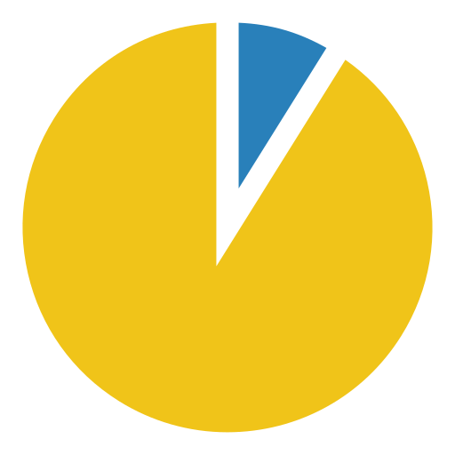


Article 8 EED: Energy savings obligation
Just transition
sub-target:
Achieve share of the total amount of energy savings among vulnerable customers and energy poor
Stepwise increase
in annual cumulative energy savings
obligation in end use:
1.3% as of 2024
1.5% as of 2026
1.9% as of 2028
Member States to define
Savings coming from direct fossil fuel combustion progressively excluded

Slide 11
Annex V(2)(a): policy objectives/ materiality
Annex V(2)(a) requires Member States:
(1) to demonstrate that one of the objectives of the policy measures reported to Article 8(1) is the achievement of end-use energy savings, and
(2) to document evidence that the reported energy savings are caused by a policy measure.
This substantiates and complements the provisions of point (c) of Article 8(14) about the eligibility of policy measures.

Slide 12
Annex V(2)(c) and (d): additionality
savings resulting from the implementation of mandatory Union law […] shall not be claimed as energy savings for the purpose of Article 8(1).
HOWEVER end-use energy savings resulting from the implementation of energy efficiency improvement measures taken pursuant to emergency regulations under Article 122 TFEU may be claimed for the purpose of Article 8(1), provided that they result in verifiable and measurable or estimable end-use energy savings, with the exception of those energy savings resulting from rationing or curtailment measures.

Slide 13
Annex V(2)(h) and (i): fossil fuels exclusion
The exclusion targets public support for installing new fossil fuel technologies
(e.g. gas boilers, ICE cars)
Behavioral/ organizational measures to decrease the fuel use in existing fossil fuel installation/equipment are not subject to this exclusion, on the contrary (!)
Phase I
V(2)(i) – non-eligible are energy savings as a result of policy measures newly implemented as from 1 January 2024 regarding the use of direct fossil fuel combustion in products, equipment, transport systems, vehicles, buildings or works
Derogation until 2030 granted to energy-intensive industries, where no alternative to ff available
Phase II
V(2)(h) – non-eligible are policy measures regarding the use of direct combustion of fossil fuel technologies that are newly implemented as from 1 January 2026
a stricter exclusion in the residential sector as of 2026 aiming at all new and existing policy measures subsiding fossil fuel combustion technologies.

Slide 14


Article 22: Information and awareness raising
Disseminate information on available energy efficiency improvement measures, individual actions and financial and legal frameworks to all relevant market actors
One-stop shops
Create one-stop shops or similar mechanisms for the provision of technical, administrative and financial advice and assistance to final customers and final users, especially household and small non-household ones, including SMEs and microenterprises
provide holistic support to all households, with a particular focus on households affected by energy poverty and on worst performing buildings

Slide 15
Thank you

