Slide 1
Introducing the session and the ENSMOV Plus project
Samuel Thomas (Regulatory Assistance Project)
How much energy do behavioural measures save?
Tuesday 28 November 2023 – BEHAVE conference

Slide 2






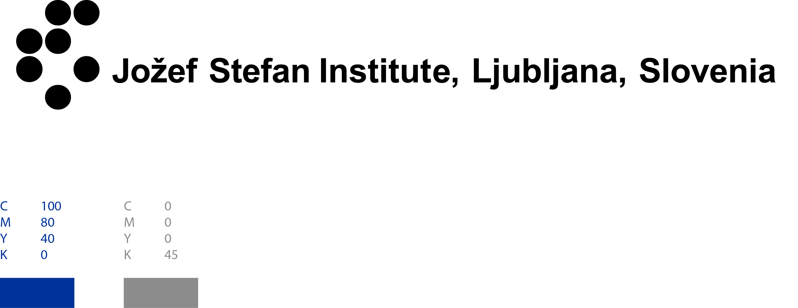






ENSMOV Plus in a nutshell
Support for the implementation of Article 7 > 8 EED
14 partners from 12 countries
8 public authorities, agencies or institutes
Target groups: public authorities & agencies, and stakeholders (energy companies, ESCos, …)
Scope: whole policy cycle
2 national associations of stakeholders
(Re)Design
Implementation
4 research labs or think tanks
Evaluation
Monitoring & Verification
Coordination

Slide 3
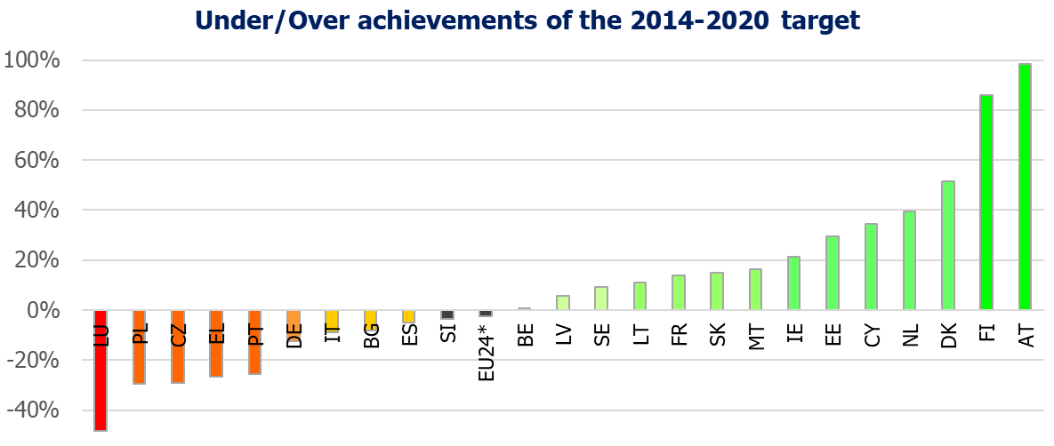
Why is experience sharing essential?
Over-achievement
Under-achievement
EU24*: data were included for 24 Member States (data missing for HR, HU and RO)
Source: Own figure from data of Table 5 in Commission’s report on the achievement of the 2020 energy efficiency targets

Slide 4
Behavioural measures reported by Member States
Notes:
Eco-driving: Belgium, Croatia, Cyprus, Estonia, Slovenia, Spain
Information campaigns: Italy, Latvia, Slovakia, Spain
Electricity Saving Check (Germany)
Energy Performance Certificates as a behavioural measures (Greece)
End-use water savings (Malta)
Monitoring of the consumption of buildings, Monitoring System (behavioural change, information campaigns) (Slovakia)
Cycle to work scheme (Slovakia)
Package of soft measures (Cyprus and Czech Republic)
List of behavioural measures reported by Member States to Article 7 EED
Period 2014-2020:
Country
Measure name
Sector
Croatia
Environmentally-friendly vehicles incentives (eco-driving)
transport
Cyprus
Soft measures (information campaigns, trainings, workshops, etc)
Cross-cutting
Cyprus
Training Eco-driving
transport
Czech Republic
Wise Energy Savings Programme
(not included in the final reporting in 2022 about the 2014-2020 period)
Cross-cutting
Greece
Energy Performance Certificates as behavioural measure
Residential and services
Italy
Information campaigns (Misura alternativa 6 Campagne di informazione)
Cross-cutting
Latvia
Regular public information education measures run by public bodies
Cross-cutting
Slovakia
Monitoring of the consumption of buildings, Monitoring System (behavioural change, information caimpaigns)
Cross-cuting
Slovakia
Cycle to work scheme
transport
Spain
Communication campaigns "Control your energy" + other communication campaigns
Cross-cutting
Spain
Energy-efficient driving, driving licence, new drivers
transport
Period 2021-2030:
Country
Measure name
Sector
Belgium
Eco-driving as part of the greening of public administrations and companies: Defense actions
Transport
Croatia
Training for drivers of road vehicles for eco-driving
Transport
Cyprus
Implementation of soft measures (information campaigns, trainings, workshops, etc).
Cross-cutting
Czech Republic
Soft energy efficiency measures in the period 2021-2030
Cross-cutting
Estonia
Promotion of economical driving + Additional promotion of economical driving
Transport
Germany
Electricity saving check
Residential (energy poverty)
Malta
End use water savings
Residential
Slovakia
Monitoring of energy consuption in buildings (Monitoring system), behaviour change - Private buildings
Cross-cutting
Slovakia
Cycling to Work
transport
Slovakia
Info-campaign
Cross-cutting
Slovenia
Promotion of eco-driving
transport

Slide 5
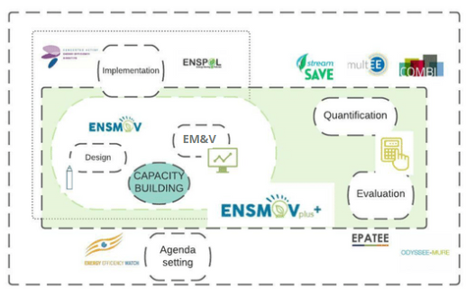
Background Objectives & outputs
Tailored resources and tools
Knowledge and experience sharing
(activities + online platform)
Two tasks on modelling (macro & micro)
Effective policy implementation
Enhanced MRV systems & evaluations
Informed (re)design of policies towards 2030

Slide 6
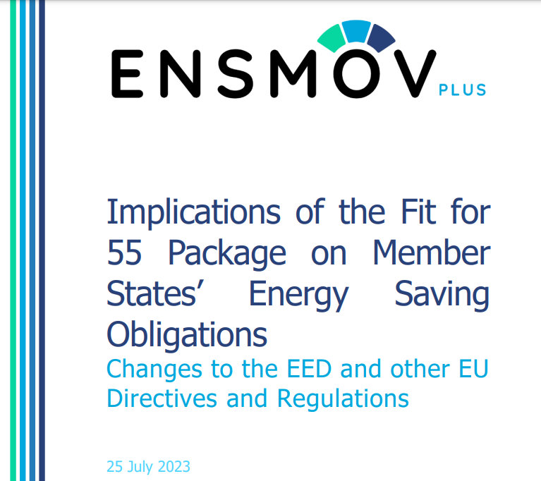
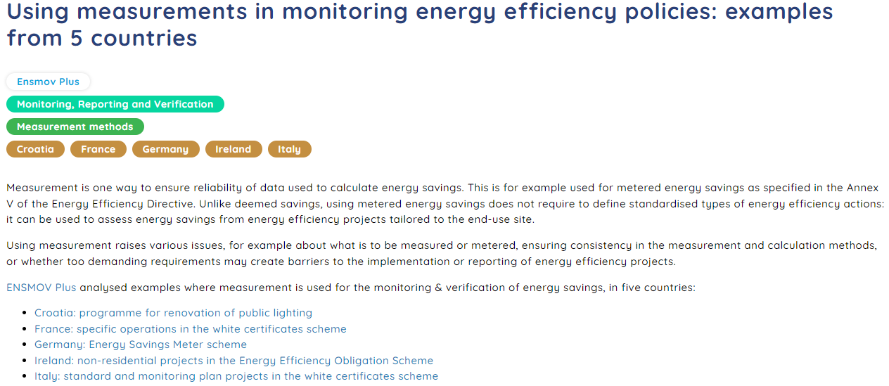
Examples of resources
https://energysavingpolicies.eu/materials/using-measurements-in-monitoring-energy-efficiency-policies-examples-from-5-countries/
https://ieecp.org/wp-content/uploads/2023/07/ENSMOVplus-D2.2-Implications-of-Ff55-Package.pdf

Slide 7

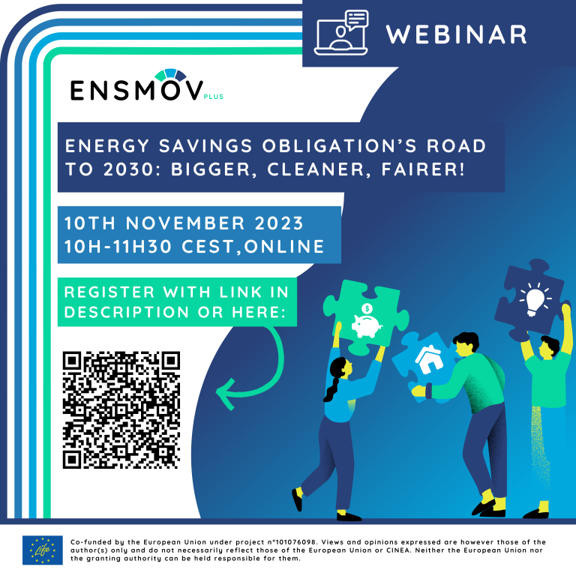

Examples of activities
https://energysavingpolicies.eu/materials/ensmov-plus-workshop-on-white-certificates-and-eeos/
https://energysavingpolicies.eu/events/energy-savings-obligations-road-to-2030-bigger-cleaner-fairer/
https://energysavingpolicies.eu/events/energy-efficiency-obligation-schemes-and-other-market-based-instruments-scaling-up-to-the-2030-targets/
+ national workshops

Slide 8
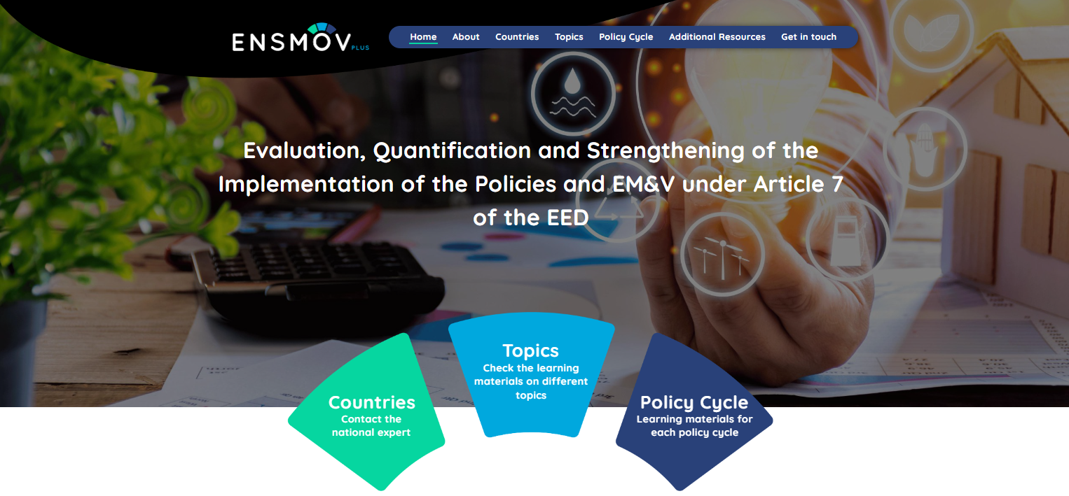
Online platform
https://energysavingpolicies.eu/

Slide 9
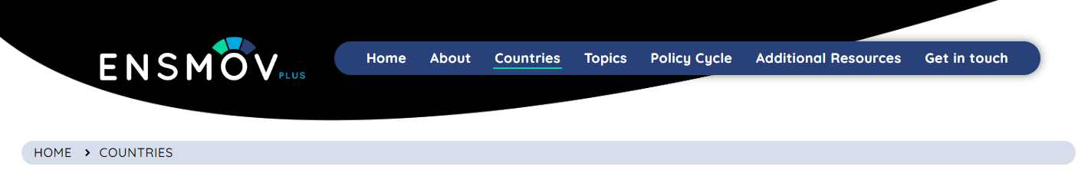
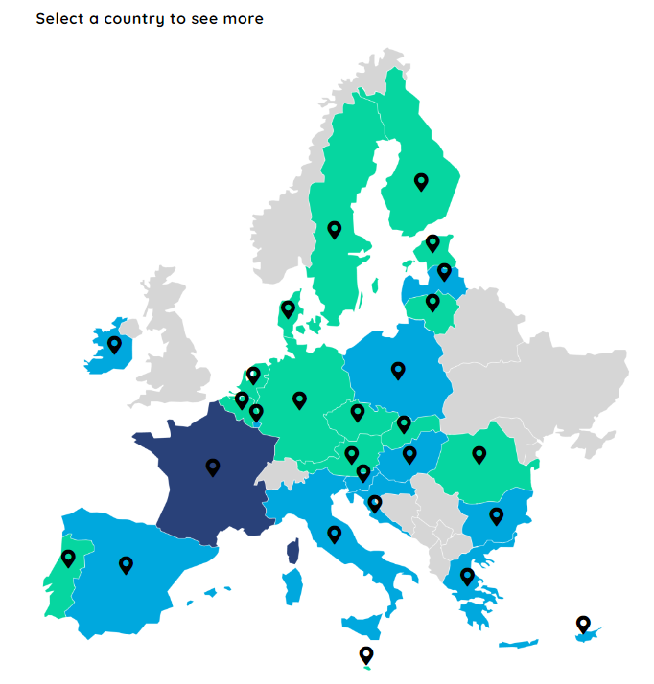
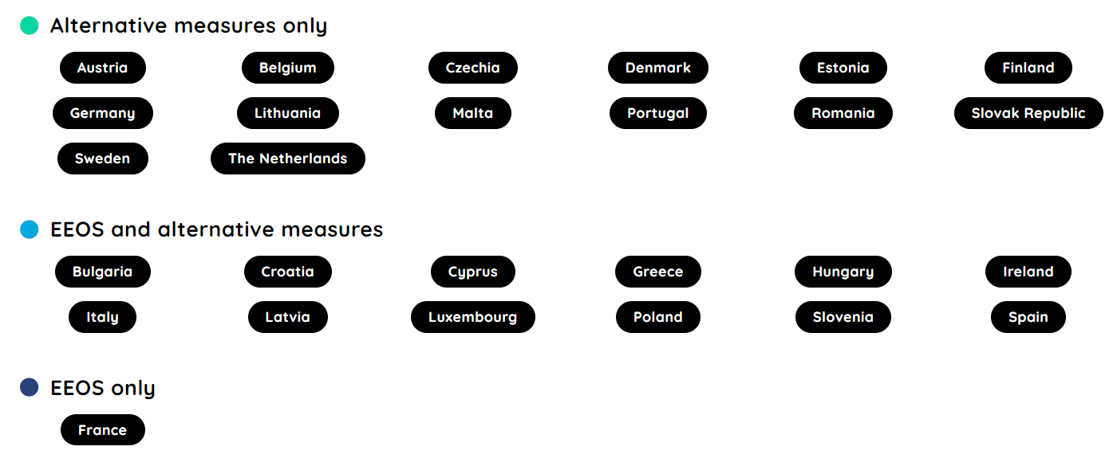
Online platform: country pages

Slide 10
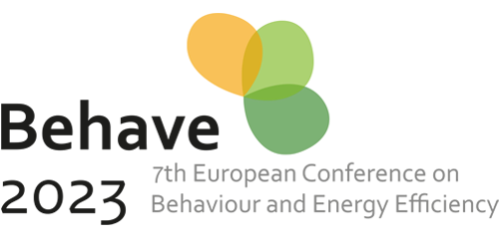
First topics covered
M&V – Use of measurement in energy savings calculations
Examples from Croatia, France, Germany, Ireland and Italy:
https://energysavingpolicies.eu/materials/using-measurements-in-monitoring-energy-efficiency-policies-examples-from-5-countries/
+ workshop proceedings:
https://energysavingpolicies.eu/materials/measurement-in-monitoring-energy-efficiency-policies-workshop-recording-and-materials/
Policy design & implementation – Energy savings potentials
Examples under development
Online workshop early 2024
Policy evaluation – Energy savings from behavioural measures
Session at the BEHAVE conference (Maastricht, NL) on 28 November (3:25PM - 4:40 PM)
https://www.behave2023.eu/

Slide 11
Learning from the Uniform Methods Project
Types of measures (residential)
Feedback on energy consumption
Reframing consumption information
Education and tips
Rewarding reductions in energy use
Comparing end-users to their peers
Games, tournaments, and competitions
Recommended Methods
Randomised Control Trials
Randomised Encouragement Designs
Key lessons
Planning essential to embed evaluation
Need accurate data on treated users and their energy consumption
Savings typically <3% (large treatment and control groups needed)
Persistence of savings complicated!
Notes:
New report on the ENSMOV plus website in pre-review form on the UMP in the US- it would be great to have someone reviewing it, and (2) we will add a short interview with one of the two authors of the protocol
Behavioural programmes have developed significantly in the US since 2008, and that due to the way the utility programmes are monitored by public utility commissions, the experience with evaluating these programmes has also grown and has been summarized by the Unified Methods Project initiated by US DOE, in a dedicated protocol.
The protocol recommends the use of RCTs, and this approach is also developing in Europe (Filippos’ presentation).
The US experience was also presented at one of the streamSAVE dialogues, to complement the streamSAVE methodology that provides the alternative approach as used in Greece (referring to Christos’ presentation).
The guidance note published by the Commission in 2019 allows both approaches, but also recommends the use of RCTs, or when not possible, quasi-experimental methods, similarly to the US protocol
We will complement the example of the US protocol with other examples (including about Greece and NUDGE) in the coming months
So follow us on LinkedIn and subscribe to the newsletter! – next slide

Slide 12

Thank you!
Meet us in Paris! (or online)
sthomas@raponline.org
Stay tuned!
https://ieecp.org/projects/ensmov-plus/
https://energysavingpolicies.eu/events/energy-efficiency-obligation-schemes-and-other-market-based-instruments-scaling-up-to-the-2030-targets/
http://energysavingpolicies.eu/

Slide 13
ENSMOV Partners

