Slide 1
EEOS in Austria
Experiences from 2015 to 2020
Österreichische Energieagentur - Austrian Energy Agency
Gregor Thenius | 25th June 2025
ENSMOV plus Workshop with Romanian Stakeholders

Slide 2


Energy Efficiency Obligation Scheme
Legal Framework 2014-2020 in brief
Energy Efficiency Act = national implementation of EED (Energy Efficiency Directive)
EEOS & Alternative Strategic Measures (Energy tax & Subsidy Programs)
Implementation of National Energy Efficiency Monitoring Agency
Decree on Energy Efficiency (according to the Energy Efficiency Act)
Standardized measures catalogue
Requirements and guidance on individual measures
Documentation requirements

Slide 3


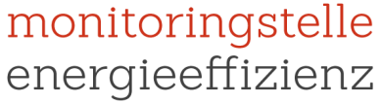
Affected groups
Energy suppliers
Federal Ministry of
Sustainability and Tourism
Public
authorities
Energy consuming
Enterprises
Austrian Federal
Computing Centre
National Energy Efficiency
Monitoring Agency
Energy service
providers

Slide 4
Energy Efficiency Obligation Scheme
Individual obligation
Previous year‘s amount of energy
sold to final customers in Austria
≥ 25
GWh
Final energy savings to be reported
0.6 %
  own company own customers other consumers
   alternative: pay a compensation of 20 cent/kWh
14
Deadline: 14th February (Year + 1)
of all savings
in households
A minimum of 40 % of final energy savings required to take effect in private households (energy use in living space) or public transport
40%
Notes:
Share >50%: (1) Relevant for 25GWh-threshold | (2) allowed to fulfil their obligation together

Slide 5
Energy Efficiency Obligation Scheme
Obligated parties
“Sales to final customers” ≥ 25 GWh
Energy suppliers with shares > 50% are considered as one company
413 obligated energy suppliers:
Oil Supplier (gas stations, heating oil delivery)
Electricity and gas suppliers
Stores (e.g. DIY superstores)
Municipal utilities & District heat
Other
$
?
Notes:
Share >50%: (1) Relevant for 25GWh-threshold | (2) allowed to fulfil their obligation together

Slide 6
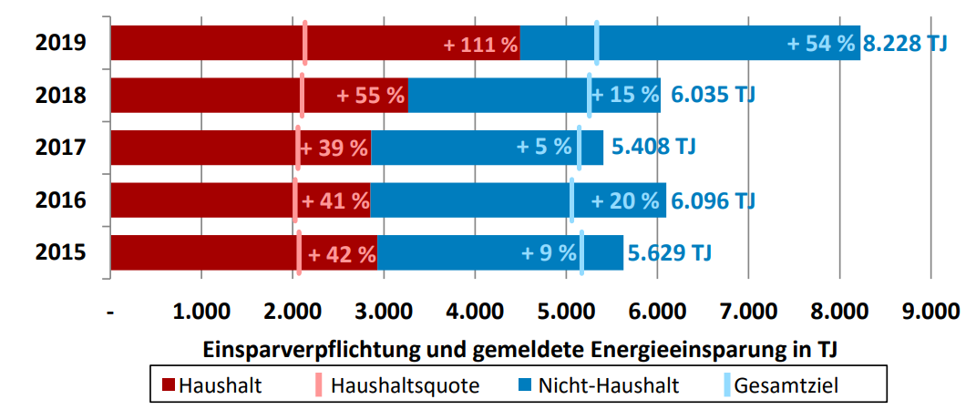
EEOS obligation and reported energy savings
Households
Quota Households
Non households
Overall target

Slide 7
EEOS measure types 2015-2020
Caveats
Heating includes water saving shower heads
Mobility includes diesel additives
Others: reporting company did not specify

Slide 8
Individual Obligation of Energy Suppliers
Eligibility of measures
General Criteria for all measures
Final energy & In Austria & Material & Additional & Lifetime until 2020
Subsidized measures not or only partly accountable (avoid double counting)
Additional Criteria for individual measures
Quality Criteria & Qualified Experts mentioned in the decree
Reporting
Reported via an online database
Necessary documents according to the decree
Banking / no Borrowing

Slide 9
Reporting of Energy Efficiency Measures
Online Application / Database
e-Government Application for the Energy Efficiency Act
Required tasks
Registration at National Energy Efficiency Monitoring Agency
Registration at e-government platform “Unternehmensserviceportal USP”
Digital identification of person responsible for reporting. Each entry into the application is personalised and is logged.
Why e-Government
Sensible data: personal data | company confidentiality
Data security: Multiple levels of security
➲ Reporting of measures via online forms

Slide 10
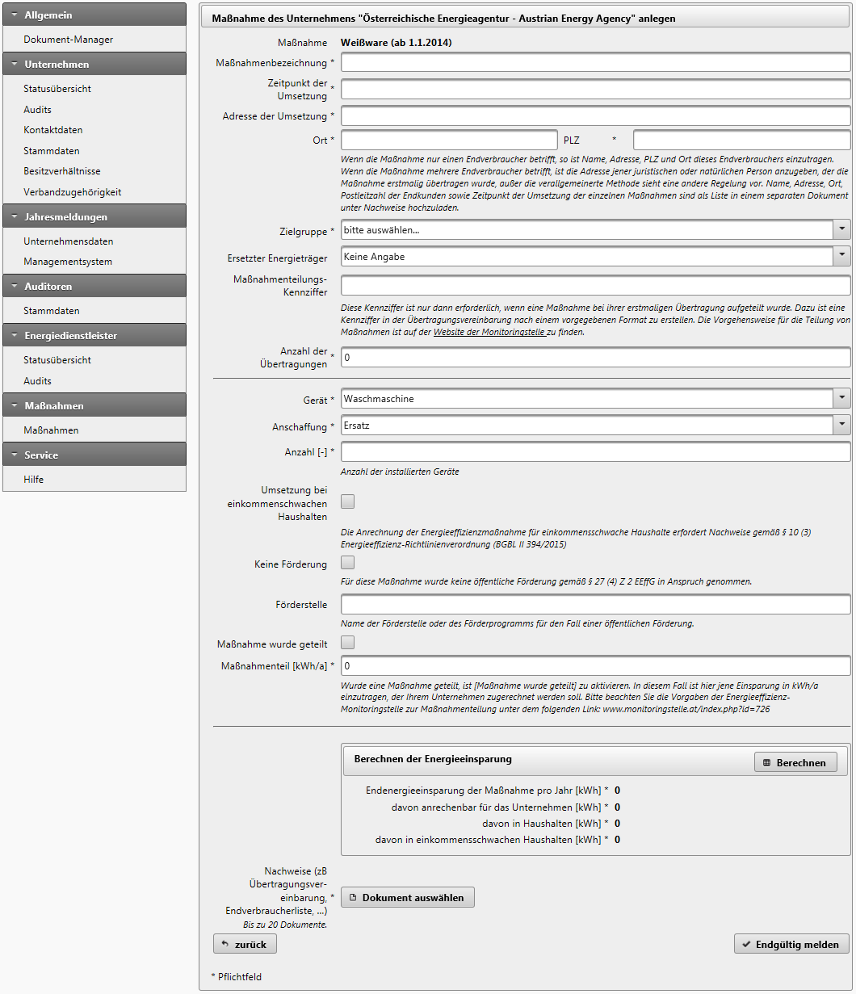
Reporting of Energy Efficiency Measures
Report form
General questions
Name of beneficiary
Date of implementation
Address of measure
Reduced energy carrier
Upload for evidence
Subsidy
Measure specific (exemplary)
Appliance type
Number of appliances
Performance
Operating hours
Calculation of energy savings

Slide 11
Energy Efficiency Obligation Scheme
Issues with reported measures of obligated parties
Additionality
Energy efficient appliances which are already in the sales mix (e.g. LED in DIY-Stores)
Final Energy Consumption
Energy Conversion, transmission and distribution
Double Counting
Especially for small energy saving actions
Data Security & availability of data
Different implementing and reporting party => no direct communication
Administrative Burden
Small energy suppliers with not enough human resources
Notes:
Share >50%: (1) Relevant for 25GWh-threshold | (2) allowed to fulfil their obligation together

Slide 12
Recommendations for a new EEOS
Think about number of obligated parties
Equip Monitoring Agency with competences of an authority
Involvement of stakeholders (obligated parties, energy service provider, …)
Centralized IT platform for reporting energy efficiency measures
Accurate definition of requirements for energy savings calculations and documentation
Competition with other policies (esp. subsidies)
Exclude behavioural change measures and critical measures from EEOS
Don’t underestimate creativity of obligated parties and other market players
Make clear the definition and boundaries of “Final Energy Consumption”
Revocation of energy efficiency measures within the EEOS
=> additional efforts & legal processes
Notes:
Examples on critical measures: Cavity wall insulation (Denmark), LED in superstores (Austria), water reducer (Austria, Italy)

Slide 13
Why the Austrian EEOS was stopped
Broad evaluation process including participation of key stakeholders from 2018 on
Bad image
  Perceived little additional savings
  Perceived high bureaucracy
  Little support from important stakeholders
  Missing legal certainty
Part of the working programme of Federal Government 2020-2024 → but during Corona pandemic no political majority for implementation

Slide 14


Contact
Gregor Thenius
Senior Expert Energy Policy
Österreichische Energieagentur - Austrian Energy Agency
gregor.thenius@energyagency.at
Tel +43 (0)664 618 0298
Mariahilfer Strasse 136 | 1150 Vienna | Austria
www.energyagency.at
  @at_AEA
In the podcast Petajoule, the experts of the Austrian Energy Agency will be answering questions to the energy future with guests from the energy sector.
Notes:
CDG

