Slide 1
The EEOS (CEE) in France
Direct support about EEOS in Romania
June 25 2025
Solenne Toum

Slide 2

Speakers
Solenne TOUM
Project Manager at ATEE's ClubC2E
Service sector
Building automation and control systems
Motors and compressors

Slide 3
Presentation of ATEE
The French Obligation scheme
French EEOS key stakeholders
Figures
Life of a standardized action file

Slide 4
Presentation of ATEE : The C2EClub
The CEE club, created in 2006, is a neutral, federating meeting place for players involved in the CEE scheme.
Its main missions are:
Develop and maintain the catalog of standard actions eligible to the scheme.
Answer questions about the CEE scheme.
Communicate to raise awareness and knowledge of the scheme.
Our missions
Organizes working groups
Disseminates information about the obligation scheme
Helps those involved in the scheme to understand, anticipate and optimize its implementation according to their activities
Is a driving force behind the development of the scheme
Stimulates and capitalizes on feedback
Our actions
Notes : ATEE: Association of Technical Energy and Environment

Slide 5
The French obligation scheme
For a given WhC-period (up to now : 3 to 4 years), the French government imposes :
  Energy suppliers of all types of energy to achieve a certain volume of energy savings with end consumers
  Applicable to all sector : residential sector (~75%), services, industries, agriculture …
These energy savings are registered as White Certificates
These are counted in kWh cumac : lifetime-cumulated and discounted final energy savings (discount rate of 4%/year)
Notes:
Quick reminder about the french WhC scheme: obligated parties must fulfill obligation with 3 options : standised actions, specific action and programs
Source : Direct support on EEOS presentation

Slide 6
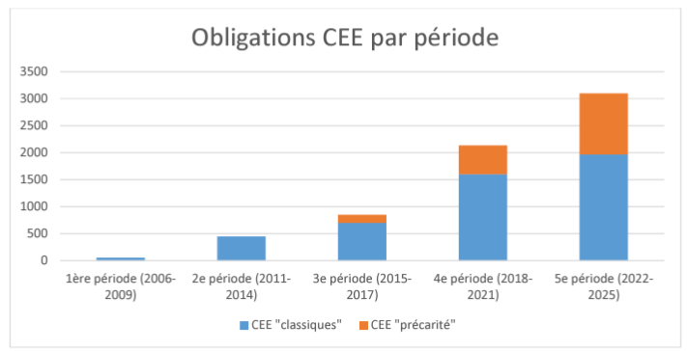
The French obligation scheme
Reminder of obligations for the 5th period (2022-2025)
Classic WhC target
1970 TWhcumac
WhC Obligations by period
Energy poverty WhC target
1130 Twhcumac
Total target for the 5th period
3100 TWhcumac
2006-2009
2011-2014
2015-2017
2018-2021
2022-2025
Classic WhC
Energy poverty WhC
Notes:
Source : https://www.ecologie.gouv.fr/sites/default/files/Bilan%20annuel%20CEE%20P5%20-%202022.pdf

Slide 7
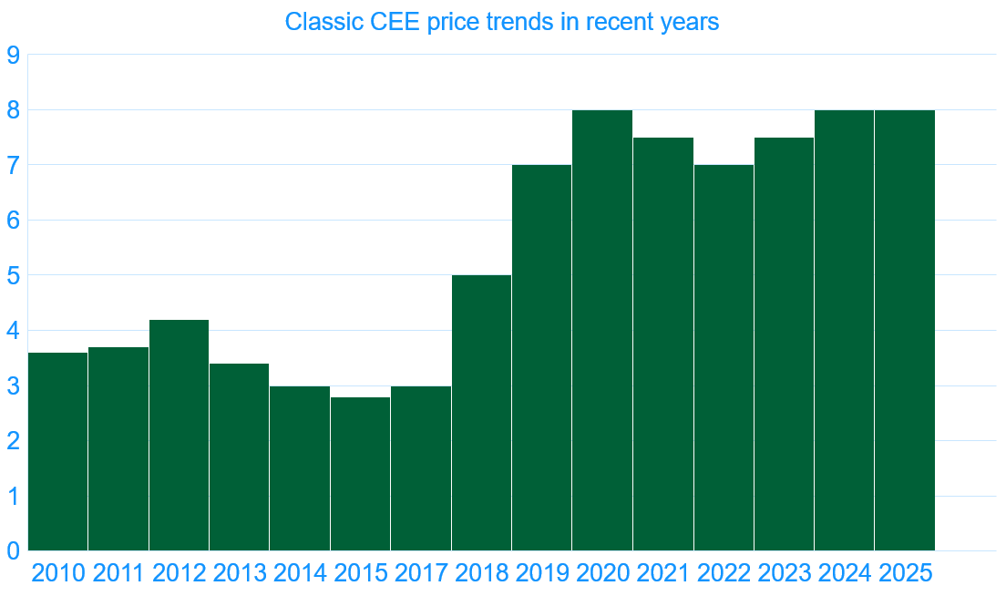
The French obligation scheme
Value of the CEE market (jan 2023- dec2023)
Classic WhC issued
402 TWhcumac
Classic WhC market price
8 €/MWhc
Energy poverty WhC market price
9 €/MWhc
Energy poverty WhC issued
157 Twhcumac
Total value for the period
~5M€
https://www.emmy.fr/public/donnees-mensuelles?precarite=false
https://www.ecologie.gouv.fr/politiques-publiques/comites-pilotage-lettres-dinformation-statistiques-du-dispositif-certificats#statistiques-de-delivrance-des-cee-2
Notes:
Source : https://www.ecologie.gouv.fr/sites/default/files/Bilan%20annuel%20CEE%20P5%20-%202022.pdf

Slide 8




What are « Energy Poverty White Certificates » in France?
Sub-target related to energy poverty in the French WhC scheme
Represents 57 % compared to the classic obligation for the current period (P5)
Implemented from 2016 as a consequence of the Law on energy transition for green growth (before: special programme and bonus factor)
Energy efficiency actions among low-income households
Specific type (and register) of WhC : « Energy Poverty WhC »
Notes:
Within the french WhC Scheme, and since 2016, Obligated parties must fulfill an amount of white certificates issued by renovation work on building owned or rented by modest or in situation of energy poverty households.
1130/1970 = 57%
These WhC are also more profitable in comparison to classic WhC wich can be an incentive for stakeholders
The WhC issued is a different kind called « Energy Poverty WhC »
Currently, obligated parties must fulfill, in addition of their WhC « classic » obligation which is calculated based on their energy sales, an obligation in energy poverty WhC wich represent 62% of their classic obligation
Sources:
https://www.ecologie.gouv.fr/dispositif-des-certificats-deconomies-denergie
https://energysavingpolicies.eu/country/france/
https://www.legifrance.gouv.fr/codes/section_lc/LEGITEXT000023983208/LEGISCTA000031747953/#LEGISCTA000031747953
https://www.ecologie.gouv.fr/sites/default/files/Bilan%20annuel%20CEE%20P5%20-%202022.pdf

Slide 9
The French obligation scheme
How to produce white certificates?
Standardized Actions
Specific Actions
WhC « Programs »
Defined by ministerial order
Deemed savings per action
226 standardized actions
(~ 50% in the building sector)
Guidelines for detailed application files
Amount of WhC specific to each project submitted
(see more details here)
Training
Information
Innovation
Energy poverty
Since 2010
Installation of high-performance equipment
3 Ways to produce white certificates : standardized, specific and programs
Notes:
Quick reminder about the french WhC scheme: obligated parties must fulfill obligations with 3 options : standardised actions, specific actions and programs
Source : Direct support on EEOS presentation

Slide 10
The French obligation scheme
Overview of the white certificate scheme in France
230 Standardized Actions (april 2025)
Residential
59 actions
BAR
Service sector
59 actions
BAT
Industry
7 actions
IND
Transport
41 actions
TRA
Agriculture
28 actions
AGRI
Networks
heating/cooling, outdoor lighting and electricity
8 actions
RES

Slide 11
French EEOS key stakeholders
Ministry of the Energy Transition
Issues White Certificates
Monitors the « market »
Sets obligation levels
and
Issues White Certificates
Sells WC
Obligated parties:
Energy providers above a certain sales threshold
Eligible parties
White Certificates exchange « market »
Buys WC
Beneficiary:
Final consumer
Active and incentive role:
Active promotion of energy efficiency actions
Active and incentive role:
Active promotion of energy efficiency actions
Energy efficiency actions
Notes:
*Eligible parties:
Local authorities
Social landlords
Mixed-economy companies and local public companies involved in energy efficiency and offering third-party financing.

Slide 12


French EEOS key stakeholders: governing the system
Ministry of the Energy Transition
ATEE: CEE club
ADEME: Public scientific experts agency
Obligated parties:
Energy providers above a certain sales threshold
Experts of their field

Slide 13
Ministry of the Energy Transition
(5CD office + PNCEE)
Missions
The 5CD office is responsible for defining the legislative and regulatory texts governing the CEE scheme, ensuring its smooth operation and compliance with its objectives within the framework of national and European policies.
The “Pôle National des Certificats d'Économies d'Énergie”, PNCEE, plays a central role in the management of the CEE scheme within the DGEC.
Actions
The 5CD office (Strategy)
Drafts legislative and regulatory texts
Leads the CEE Steering Committee
The PNCEE (White certificate delivery)
Processes CEE applications / issues CEEs
Implements control operations;
Using commissioned agents, observes infringements and pronounces specific sanctions for these infringements;
Manages and sets individual obligations;
Carries out administrative reconciliation at the end of the period;
Communicates and informs about the system;
Informs prefects and decentralized departments about actions within their territories;
Archives supporting documents.
Le Club C2E

Slide 14
ADEME: Public scientific experts agency
Missions
Expertise on behalf of the ministry
Independent appraisal
Promotion/information/communication on the CEE scheme
Actions
Are included in the approval processes of the creation/revision of Standardized Action sheets.
Validates calculations proposed by ATEE working groups.
Appraise specific action files at the request of the PNCEE (Ministry).
Carries out potential studies before each period
Launches independent studies on the CEE scheme (evaluation/exploratory studies on carbon integration in the scheme).
Signs CEE Program agreements;
Produces guides (companies, local authorities, specific operations on fixed installations, specific transport operations), website: CEE calculator
Organizes national technical days (500 participants) at the end of each period
Organizes national or regional workshops/meetings/webinars

Slide 15
In France, the building sector has a central role in the scheme
Energy consumption by sector in 2019
Final energy consumption by sector
16%
White certificates issued (2019-2021)
7%

Slide 16
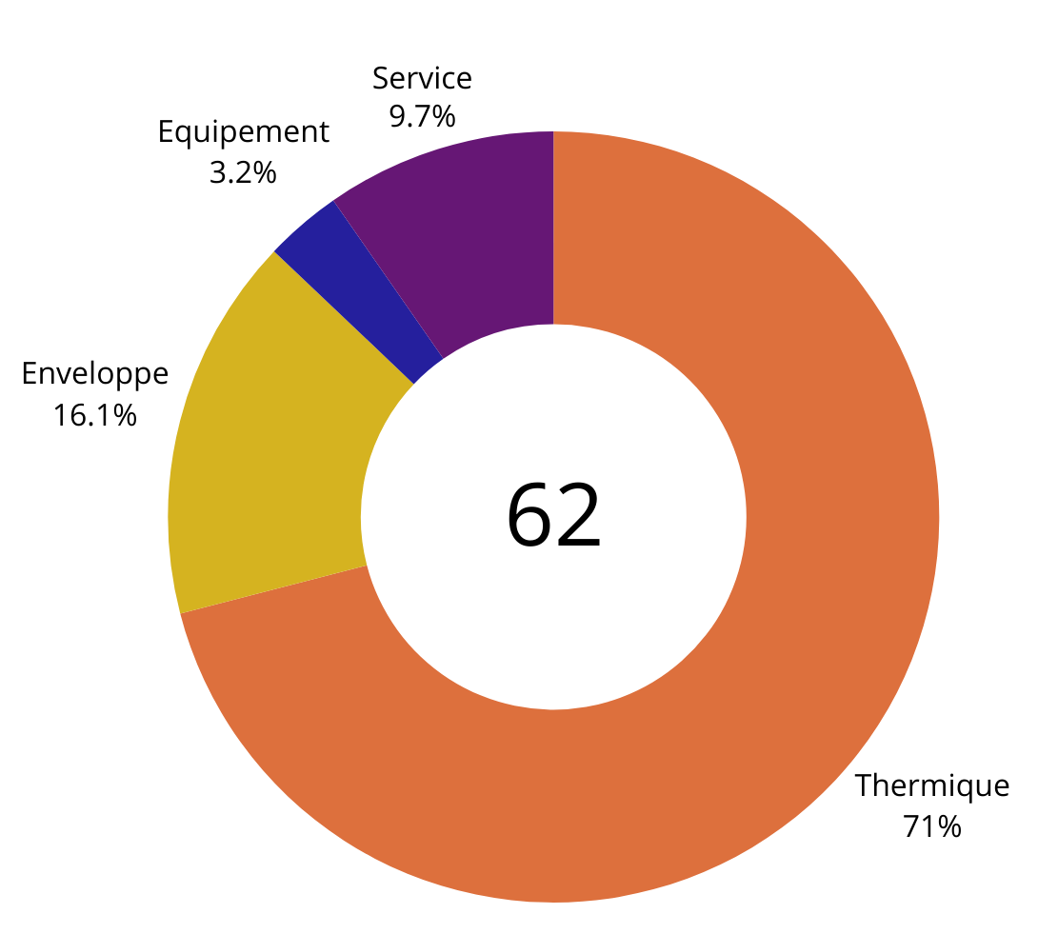


70% of the CEE generated comes from the residential building sector
BAR-EN-101: Insulation of attics or roofs
BAR-TH-160: Insulation of a heating or domestic hot water hydraulic network
BAR-TH-104: Air/water or water/water heat pump
7
billion euros
are allocated for energy renovation of buildings as part of France’s Recovery Plan through Ma Prime Renov program.
59 actions
The catalogue of standardized actions for the residential sector includes 59 action types dedicated to renovation works, including works by gesture (single actions) and deep renovation.
Bonuses cover different types of work : Heating systems, Smart Heating Control and Deep Renovations.
Notes:
Initiation d’un travail sur les fiches régulation : Création de la BAT-TH-160, Révisions Optimiseur de relance BAT-TH-109, BAT-TH-116
Massification des pompes à chaleur dans le tertiaire : Création BAT-TH-158 Pompe à chaleur réversible de type air/air, Révision BAT-TH-113Pompe à chaleur de type air/eau ou eau/eau
Actualisation et créations de fiches sur l’enveloppe du bâtiment :BAT-EN-113 Façade rideau ou semi-rideau avec vitrage isolant, BAT-EN-104 Fenêtre ou porte-fenêtre complète avec vitrage isolant
Mise à jour des fiches liées aux réseaux de chaleur : Création BAT-TH-159 Raccordement d'un bâtiment tertiaire à un réseau de froid, Révision BAT-TH-127 Raccordement d'un bâtiment tertiaire à un réseau de chaleur, BAT-TH-146 Isolation d'un réseau hydraulique de chauffage ou d'eau chaude sanitaire, BAT-TH-155 Isolation de points singuliers d'un réseau

Slide 17
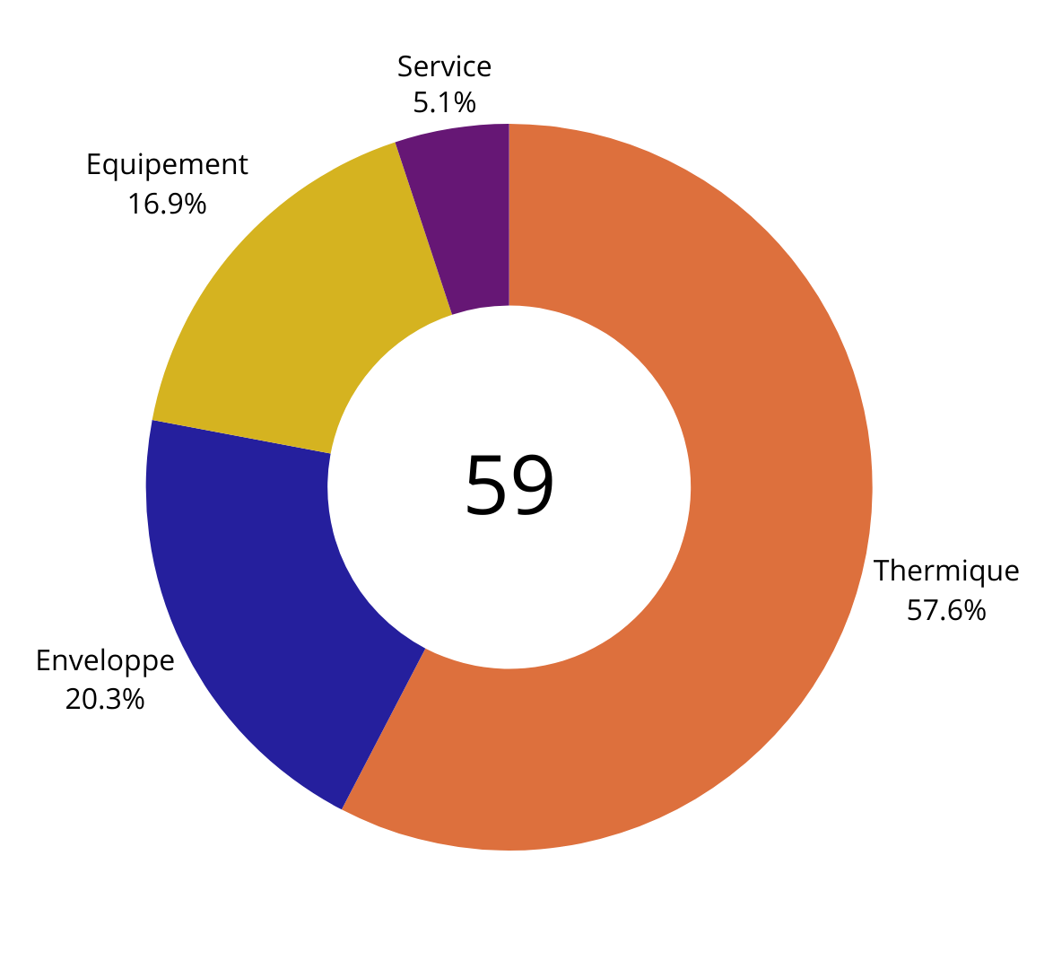
Energy savings the tertiary sector
59 actions
Heating and cooling systems
Most valorised actions within the scheme :
BAT-TH-146: Insulating a Hydraulic Heating or Domestic Hot Water System
BAT-EN-103: Floor Insulation
BAT-TH-116: Building Management System
BAT-TH-139: Heat Recovery System on a Cooling Unit
BAT-TH-134: High Pressure Refrigeration Unit Regulation System
Notes:
Préciser : équipement = moteurs, éclairages, systèmes hydro-économes
Service = contrats de performance énergétique, monitoring, désembouage

Slide 18
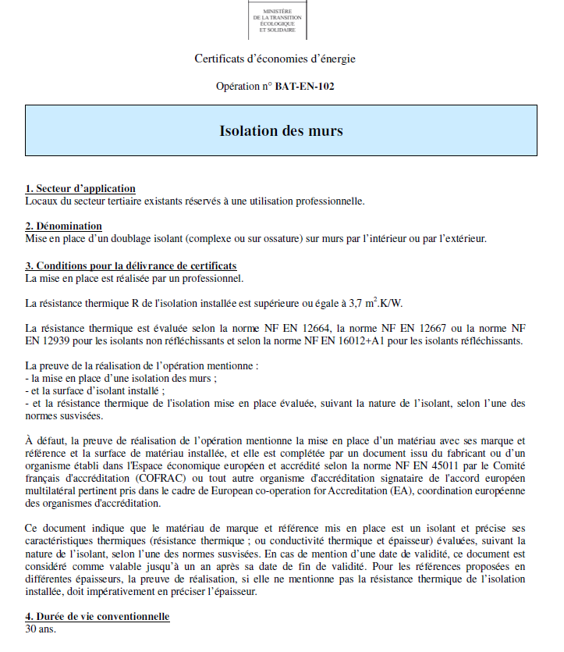
What is a WhC standardized action sheet? 1/2
ALL SHEETS ARE WRITTEN THE SAME WAY = SAME TEMPLATE
Fiche BAR–EN-102
Area of application: Gives the scope of the operation, specifying whether the operation applies to new or existing buildings, collective or individual dwellings.
Description: Explanation of the operation to be valued (purchase of equipment or rental, valuation of a service, etc.).
Conditions for issuing certificates: Criteria for the technical and practical requirements that the equipment and/or its installation must meet.

Slide 19
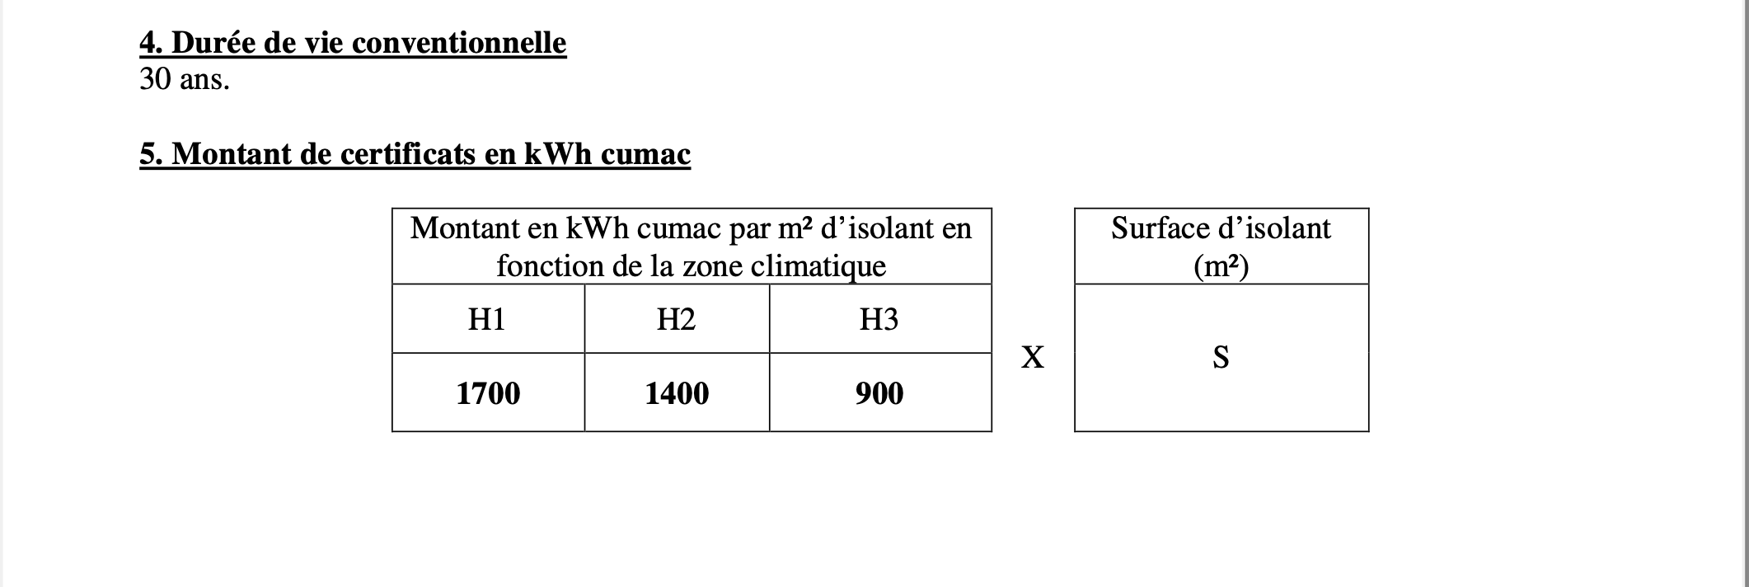
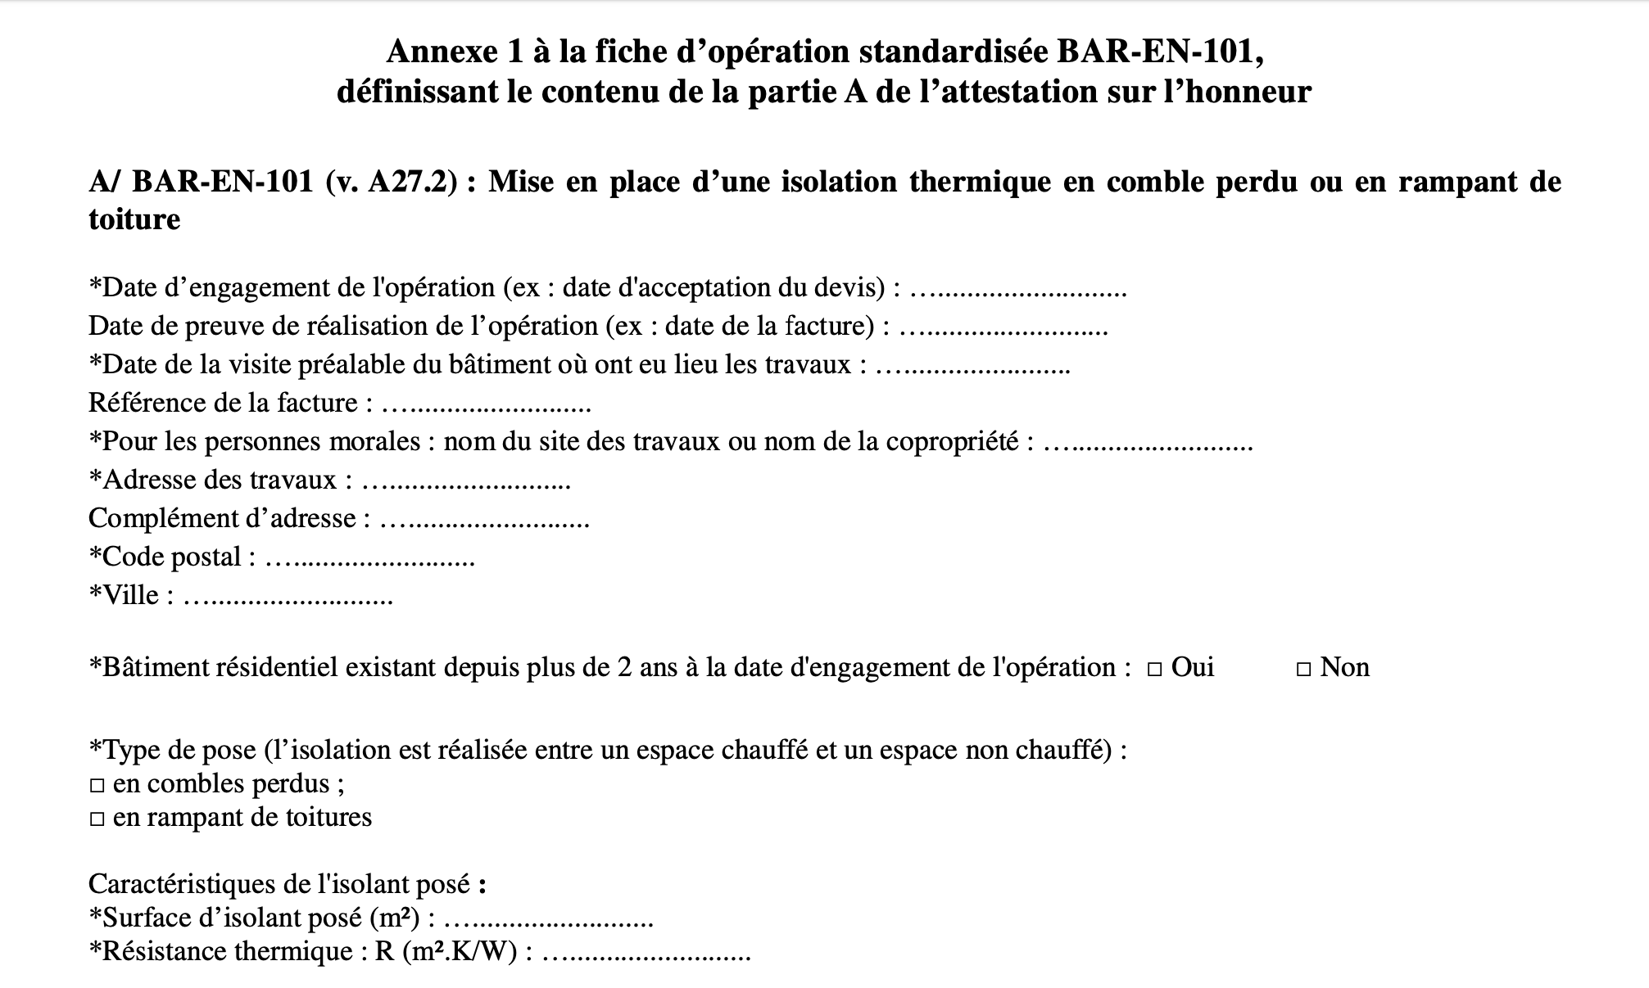

What is a WhC standardized action sheet? $2/2$
ALL SHEETS ARE WRITTEN THE SAME WAY = SAME TEMPLATE
4. Duration of the operation being valued: This is associated with the equipment installed or the service.
5. Amount of certificate in kWh Cumac :Final energy savings achieved by the operation over the (discounted) lifetime of the operation.
Appendix : This includes part A of the declaration on honour concerning the operation's eligibility criteria.

Slide 20
Life of a white certificate standardized file
Up to 12 months to submit the WhC application on the online platform EMMY
2
3
4
5
Identification of the engagement date of the action
Identification of the date of completion of the action
On site and by contact verification
verification by the PNCEE (on sample)
WORK
1
START
END
Proof of the active and incentive role
WC application
Trade agreement
Technical visit
Quotation or order form
Declaration of honour
Invoice
Inspection report for each operation
Summary of verifications by contact and on site
Postal Mailing

Slide 21





MERCI
More informations on : www.atee.fr

