Slide 1
Introducing ENSMOV Plus and quick overview of EEOS in Europe
Jean-Sébastien Broc (IEECP) and Samuel Thomas (RAP)
Workshop with the Romanian Energy Efficiency Council | Wednesday 25 June – online

Slide 2






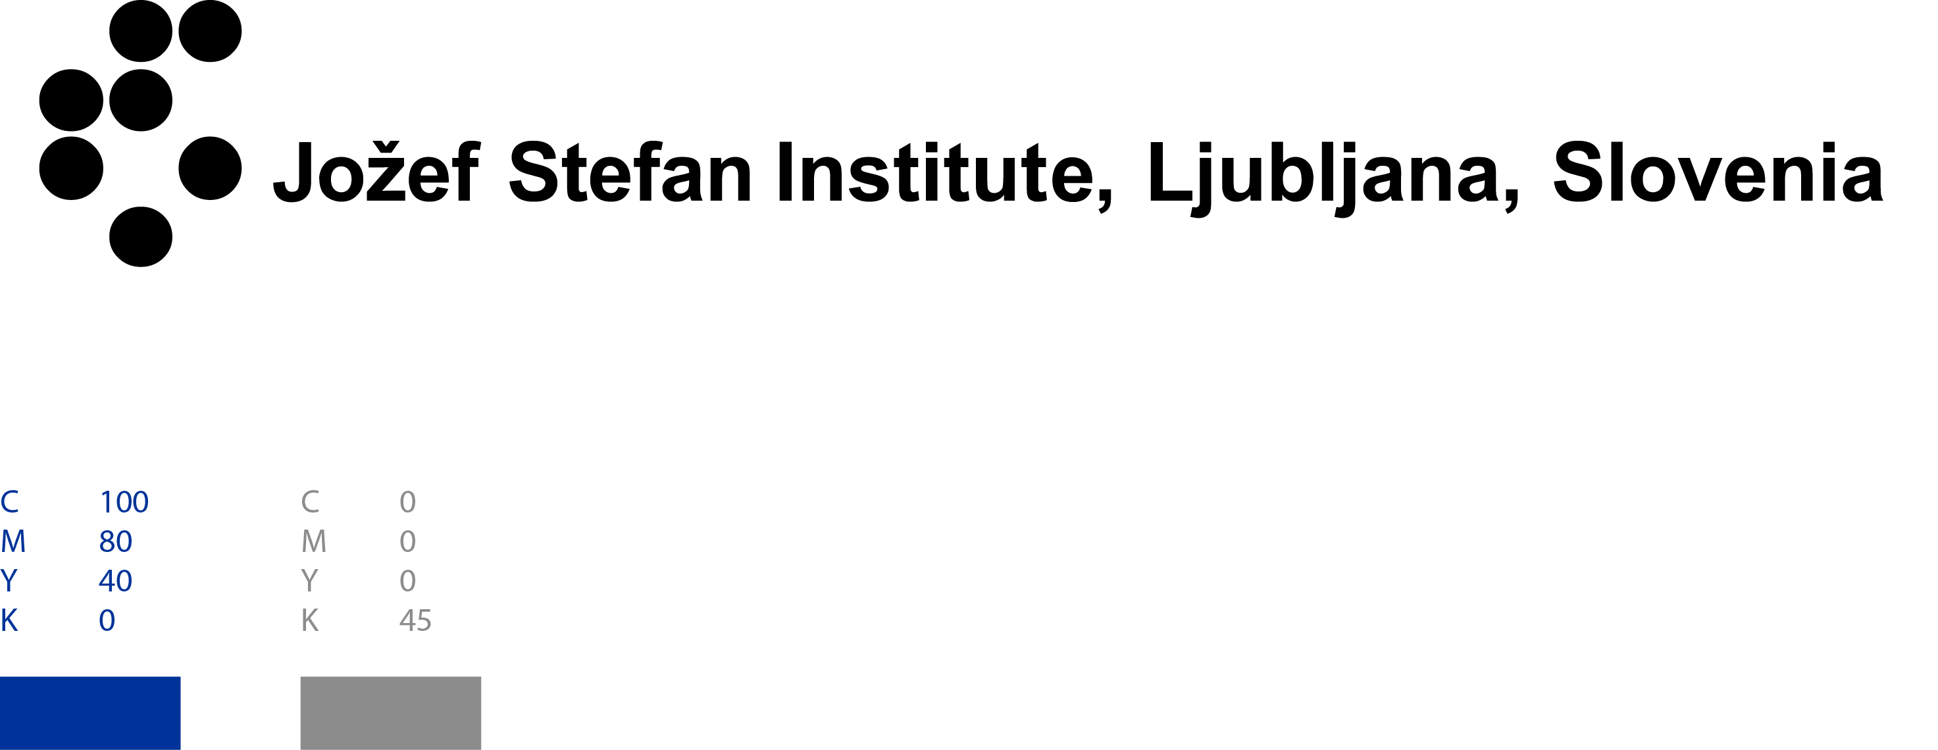






ENSMOV Plus in a nutshell
Support for the implementation of Article 7 > 8 EED
14 partners from 12 countries
8 public authorities, agencies or institutes
Target groups: public authorities & agencies, and stakeholders (energy companies, ESCos, …)
Scope: whole policy cycle
2 national associations of stakeholders
(Re)Design
Implementation
4 research labs or think tanks
Evaluation
Monitoring & Verification
Coordination

Slide 3
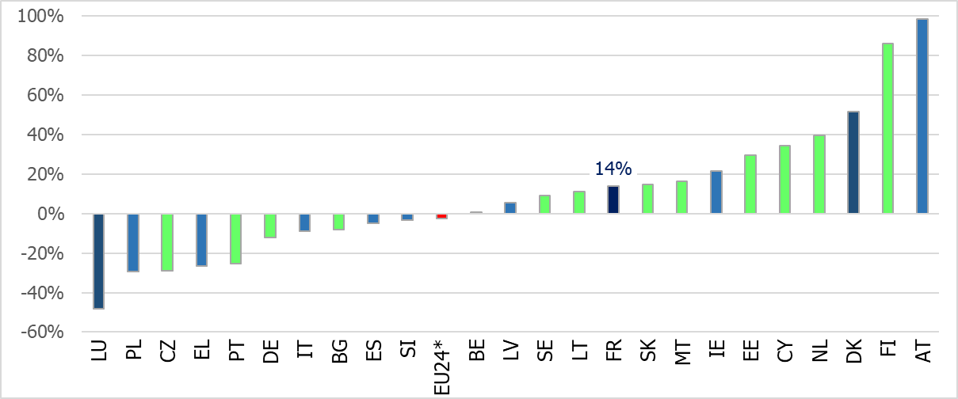
Why is experience sharing essential?
Under- / Over- achievements of required amount of cumulative energy savings for 2014-2020
EEOS only
Over-achievement
EEOS + Alternative measures
Alternative measures only
Under-achievement
-2,5%
EU24*: data available for 24 Member States
Source: Own figure from data of Table 5 in Commission’s report on the achievement of the 2020 energy efficiency targets

Slide 4
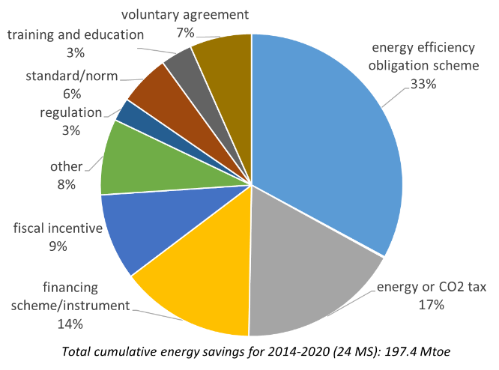
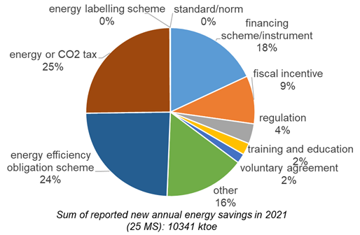
EEOS in EED energy savings obligation
Yesterday (2014-2020)
Now (2021)
Source: Commission’s report on the achievement of the 2020 energy efficiency targets
Source: Commission’s report on NECPR (National Energy and Climate Progress Reports) 2023

Slide 5
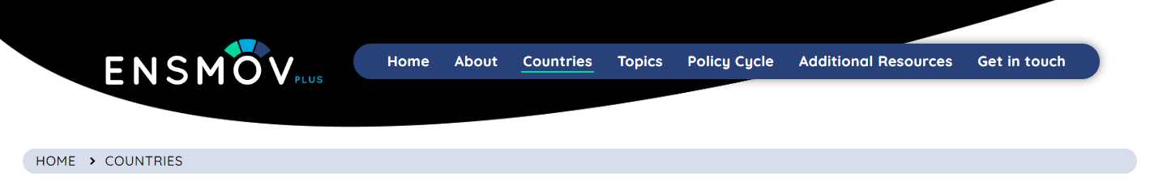
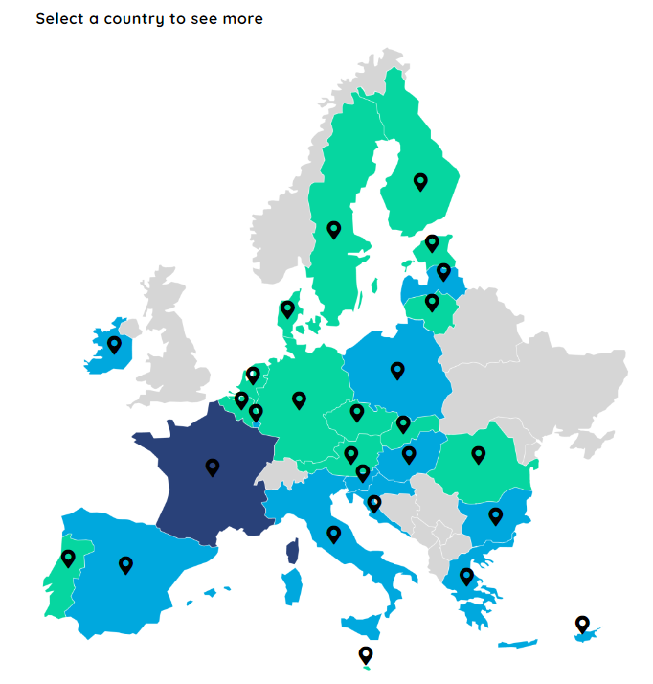
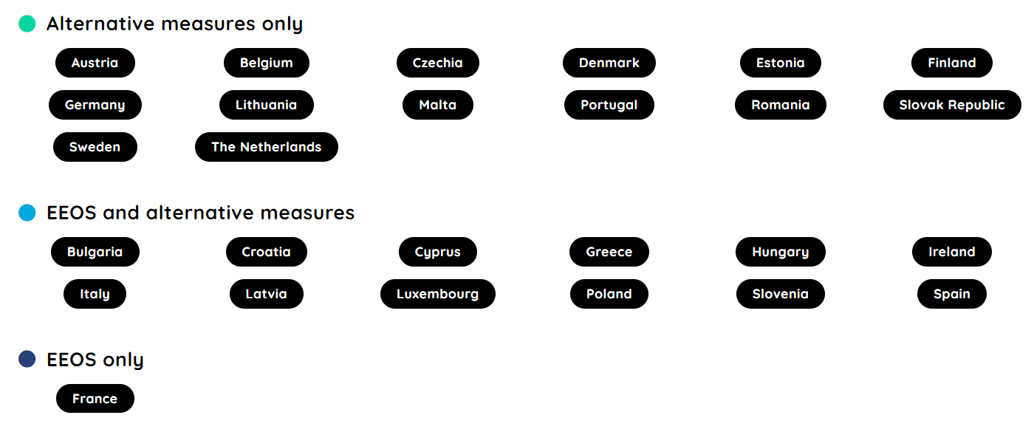


Overview of EEOS as of today
https://energysavingpolicies.eu/
White certificates scheme
Changes vs. 2014-2020
Closed
Started
Austria (2020)
Denmark (2020)
Hungary (2021)
Cyprus (2023)
+ white certificates in Spain (2023)

Slide 6
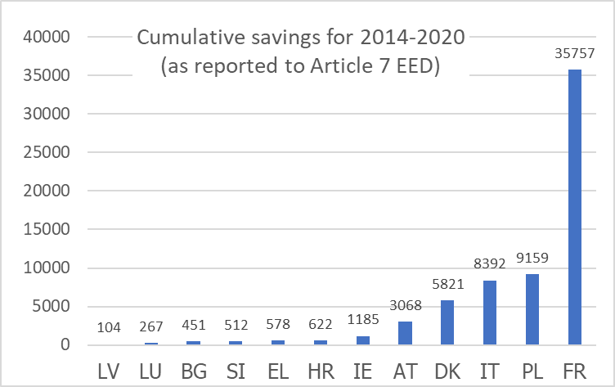
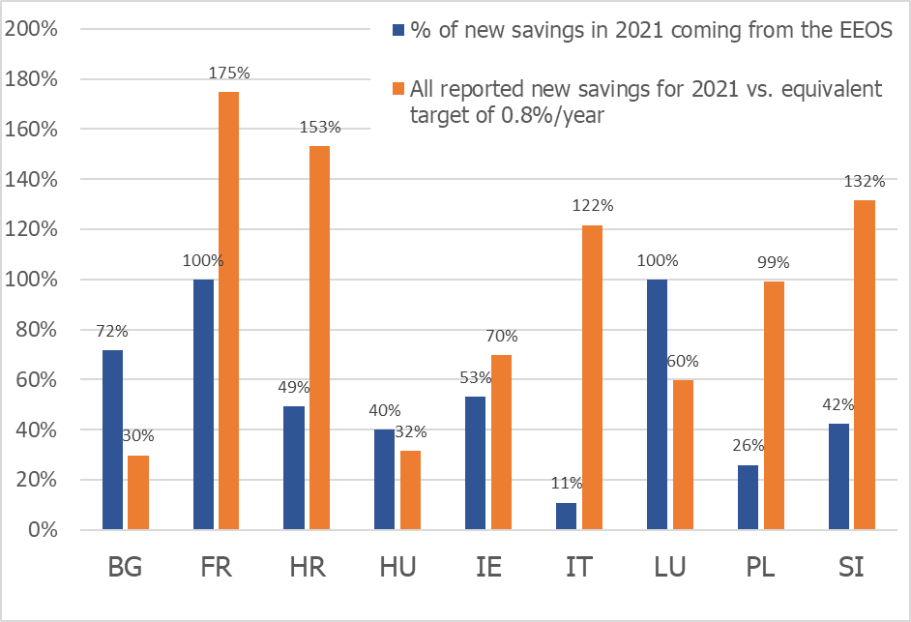
Overview of EEOS’ results
Yesterday
Today
For Spain: savings were reported from the EE Fund until now
Hungary’s scheme started in 2021
Cyprus’ scheme started in 2023
Greece and Latvia reported the savings from their EEOS as part of the policy package (so not possible to separate the savings from the EEOS only)

Slide 7
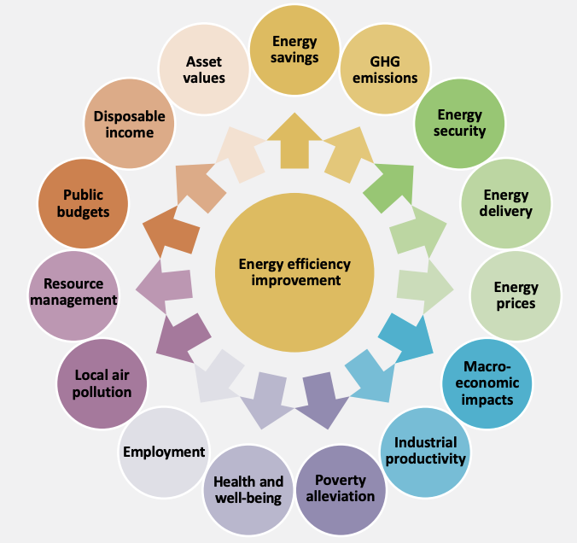
Rationale for EEOS
Energy Efficiency Resource Standards in the US
  Saving energy costs less than supplying energy
Develop ESCo market
  Private sector can be more innovative than public sector
Achieve multiple benefits of energy efficiency through market-based instrument
Source: IEA (2014) Mutiple Benefits of Energy Efficiency
Notes:
Resource planning
ESCOs developed
Private market actors more innovative

Slide 8
Lessons learned: 20 years of EEOS in the EU
Be clear about objectives and align them with scheme rules
Start small and grow
Provide clear guidance for scheme participants, particularly on energy savings calculations
Ensure sufficient resources are available for monitoring and verification
Set dissuasive penalties
If using a buy-out price / substitution fee, set it at a level that is higher than the expected costs of most actions available to obligated parties
Notes:
Resource planning
ESCOs developed
Private market actors more innovative

Slide 9
Key benefits of EEOS
Give visibility to energy efficiency / energy savings markets
Increase credibility of energy efficiency actions (cf. catalogue of eligible action types ; validation of energy savings)
Provide a complementary source of funding for EE investments
Stimulate new market opportunities for both, incumbent players (e.g. energy suppliers) and new comers (e.g. ESCos)
Communication / marketing means of energy suppliers much stronger than the ones of public bodies

Slide 10

Thank you!
jsb @ ieecp.org
Stay tuned!
https://ieecp.org/projects/ensmov-plus/
http://energysavingpolicies.eu/

Slide 11
ENSMOV Partners

